Slide 1
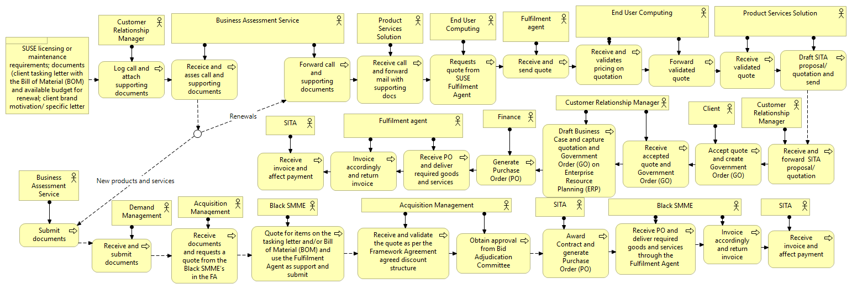
SUSE Framework Agreement Engagement Model Process

